Slide 1

Pupil Consultation
School Council Meeting
Key Stage Two children
Aim: get their views of PSHE
What will be taught?
What is important to you?
What do you like to learn about?
What do you wish you could learn more about?

Slide 2
PSHE and RSE at Matching Green CofE Primary School
Pupil Consultation

Slide 3
PSHE and RSE themes
Do you know any topics/ themes that are covered in PSHE/ RSE at Matching Green Primary School? Discuss.
Let’s take a look…

Slide 4
Healthy Relationships
What it means to be a friend, what is fair and unfair, knowing our special people and what makes them special, knowing about how to give and receive permission to do things (consent), recognising positive and healthy relationships, knowing when people are being unkind or hurtful, challenging teasing and bullying, difference between off line and online relationships

Slide 5
Money
Money, how to keep it safe, choices we have about how we spend money, how we can save money, knowing what the difference is between a want and a need, how we can use money to help others

Slide 6
Keeping safe
Online safety, first aid, recognising risks in situations, ways of taking care of ourselves, road/travel safety, knowing whom to go to when we are worried or afraid

Slide 7
Rights and responsibilities
Exploring differences and similarities between people, belonging to different groups, recognising stereotypes, rules we have to follow and responsibilities we have

Slide 8
Healthy lifestyles
Taking care of our bodies and our minds, smoking and alcohol, how medicines and drugs can help us, healthy food choices, physical exercise, sleep and rest, taking care of our skin and teeth, germs and diseases

Slide 9
Media influence
How the media can affect how we feel about ourselves and our bodies, influence of social media on friendships and relationships, attitudes and decisions, recognising the difference between things that are private and things that are public

Slide 10
Hurtful behaviour and bullying
Knowing how to solve disagreements in a kind way, recognising that friends can put us under pressure, recognising all types of bullying and hurtful behaviour including online, knowing whom to go to when we need help with relationships both in and out of school

Slide 11
Growing and Changing
Growing older, changing emotions and feelings, changes in our bodies, taking care of our bodies and protecting them, differences and similarities between boys and girls, acceptable and unacceptable physical contact, how babies are made, different kinds of friendships and relationships, managing change e.g. to new school/leaving school

Slide 12
Valuing difference
Celebrating how we are the same and the way s in which we are different, developing mutual respect for people who are different to us, recognising what makes people special to us and to others

Slide 13
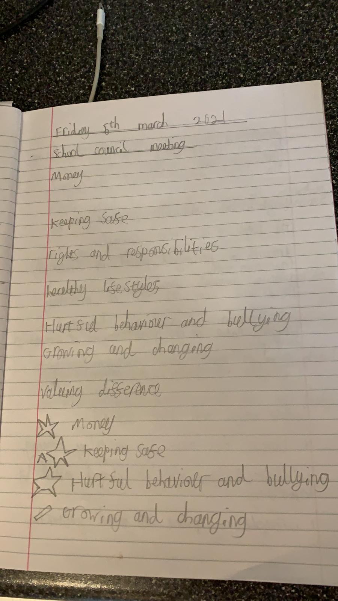

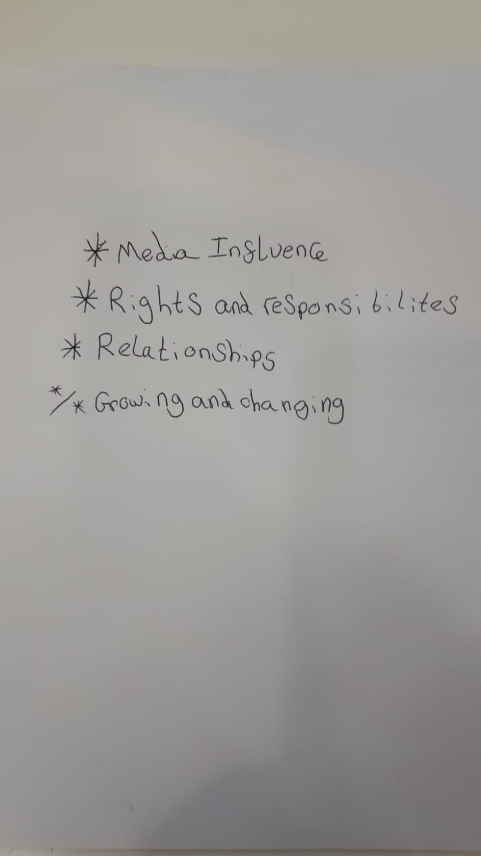
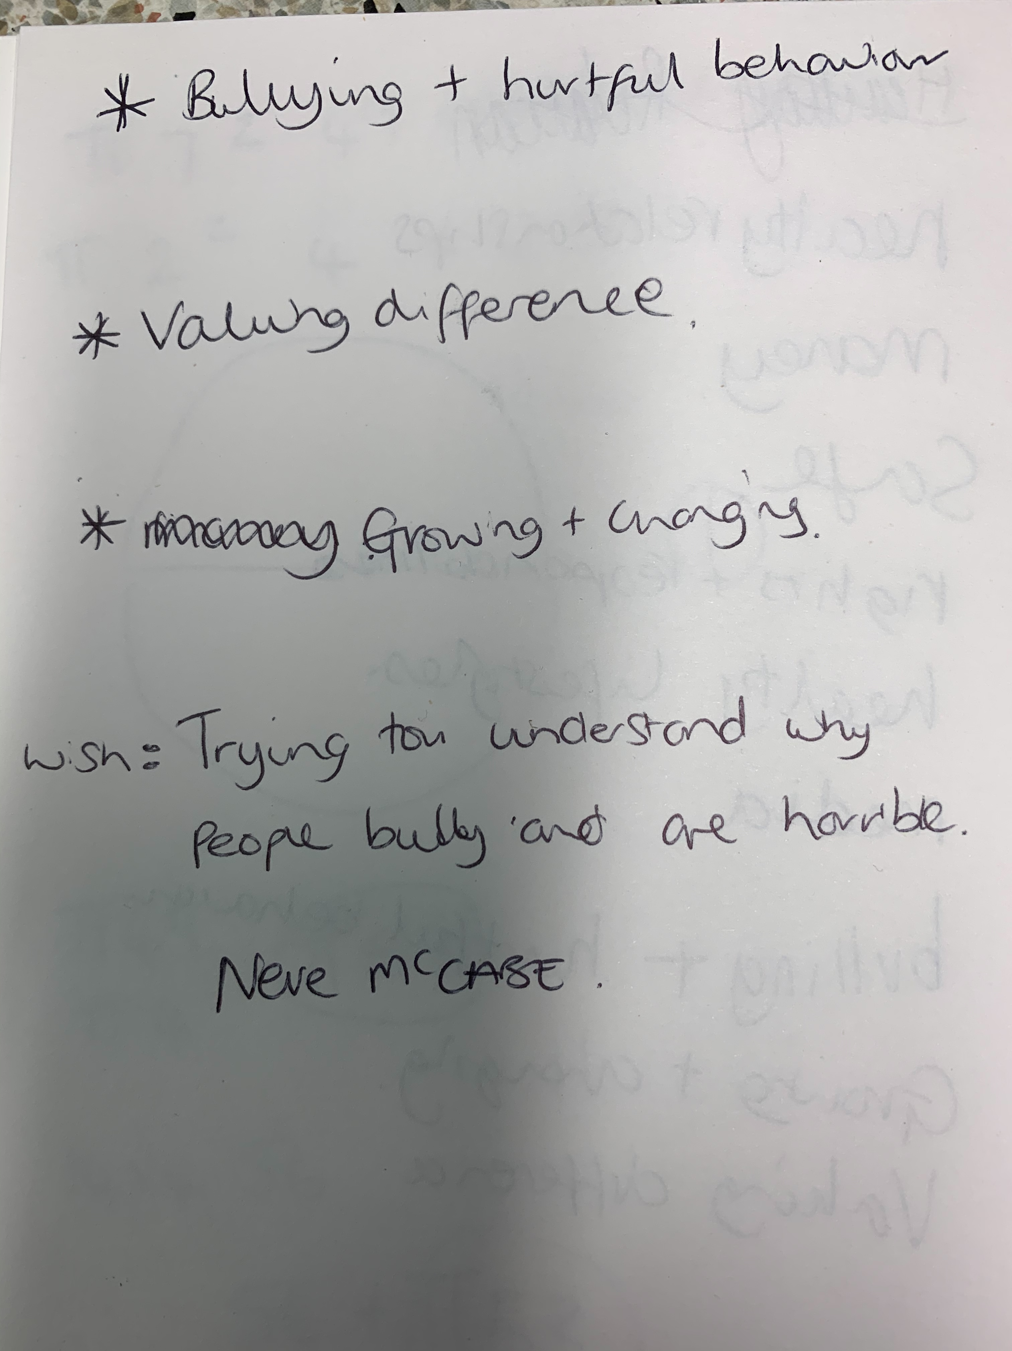
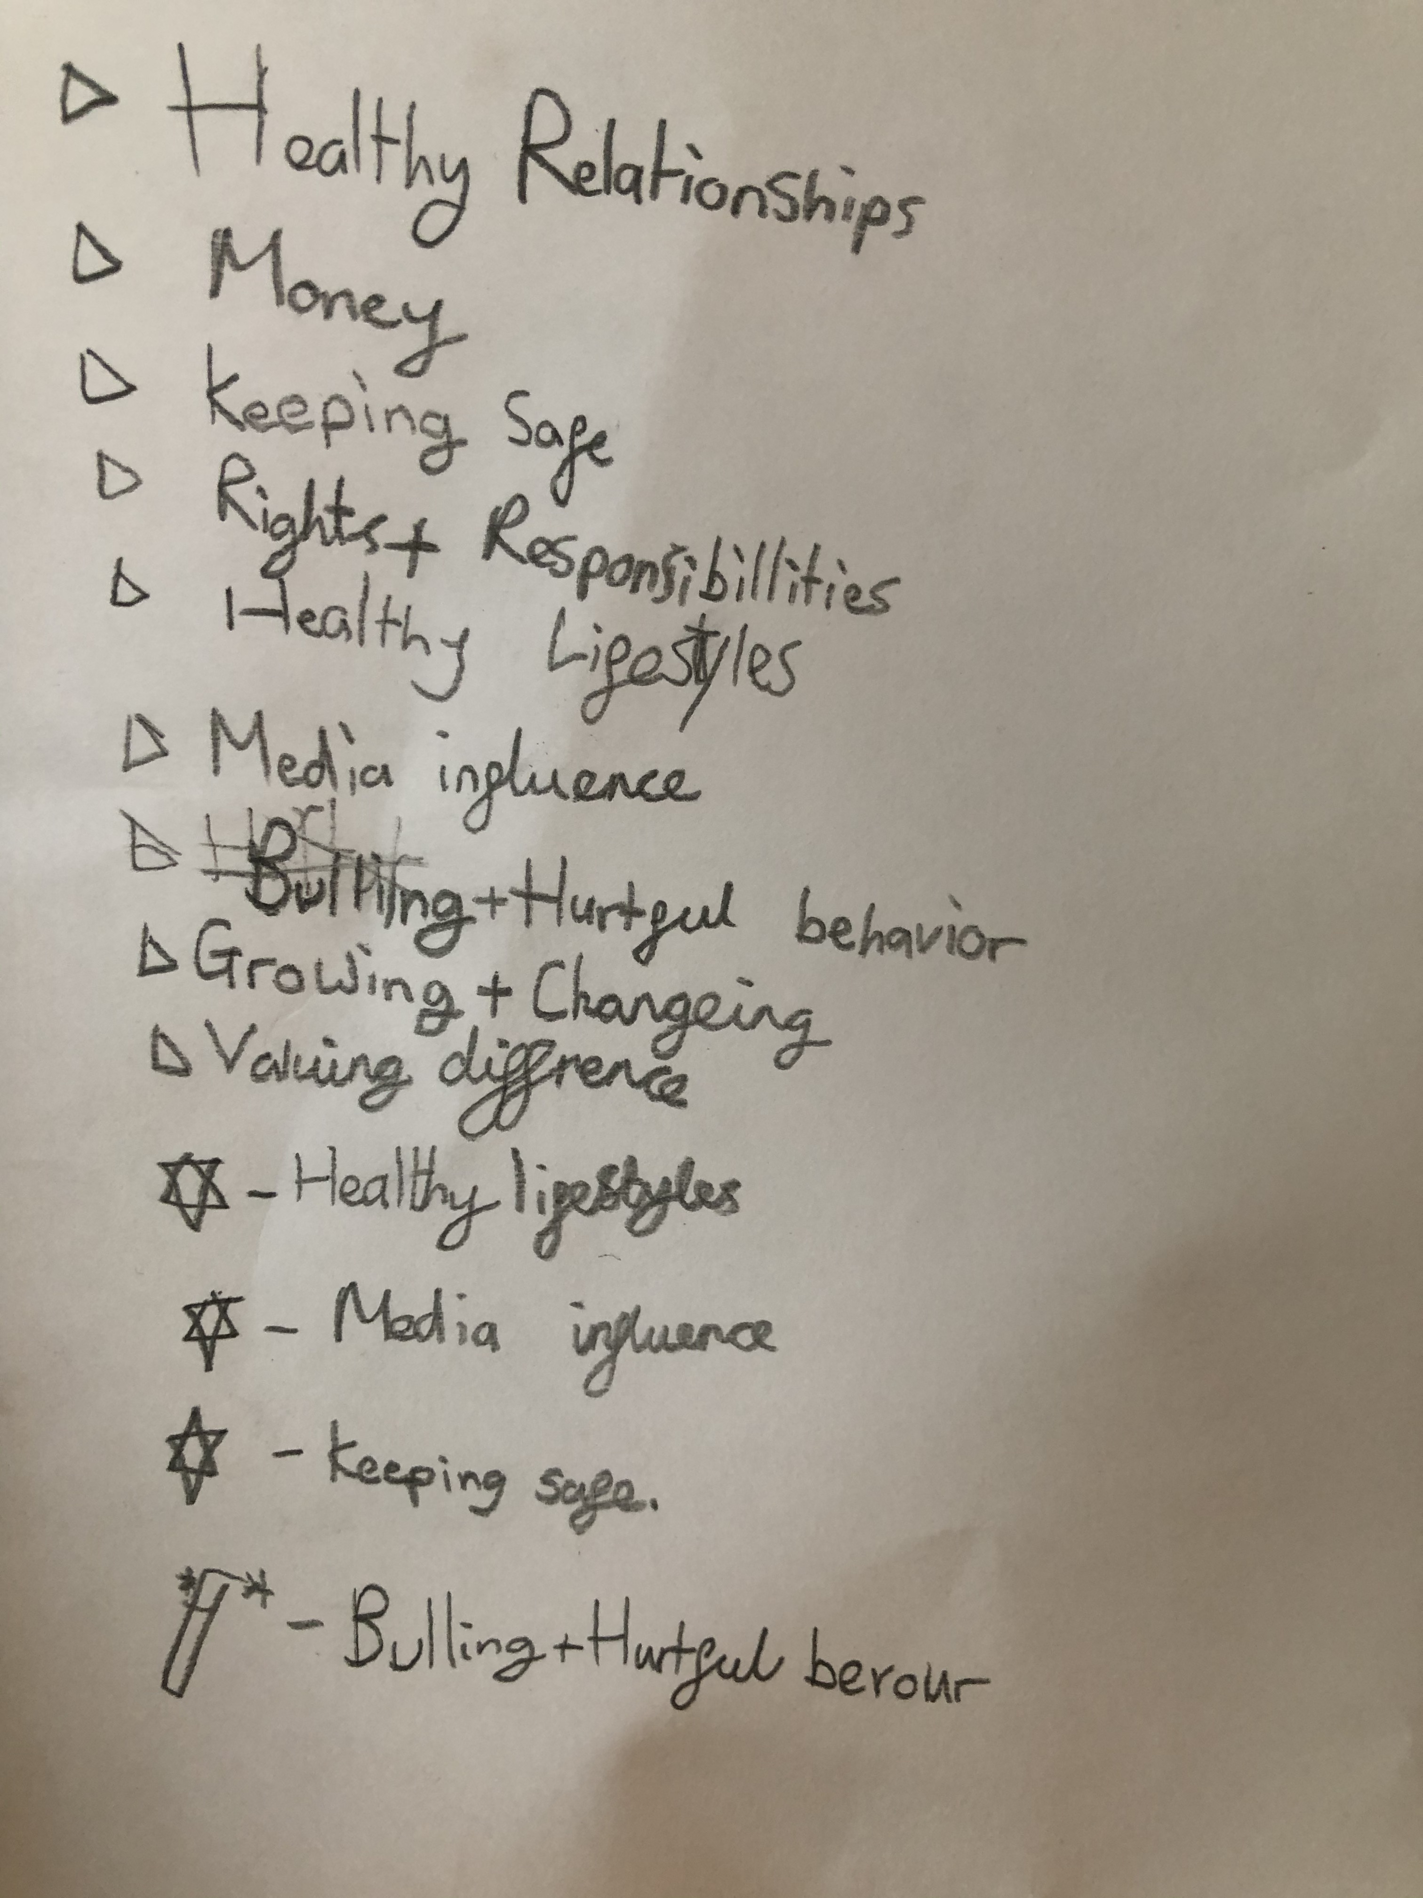
Think about the topics discussed before and try to think of 3 things you will like/ enjoy learning about in PSHE and 1 thing you want to know more about…

Slide 14
Results
Both children from Darwin class wanted to learn more about bullying and hurtful behavior.
Both children from Shakespeare class wanted to learn more about growing and changing.
One child commented ‘people in my class are changing already and they didn’t know why’.

