Slide 1
RSE Parent Consultation
12th March 2021

Slide 2
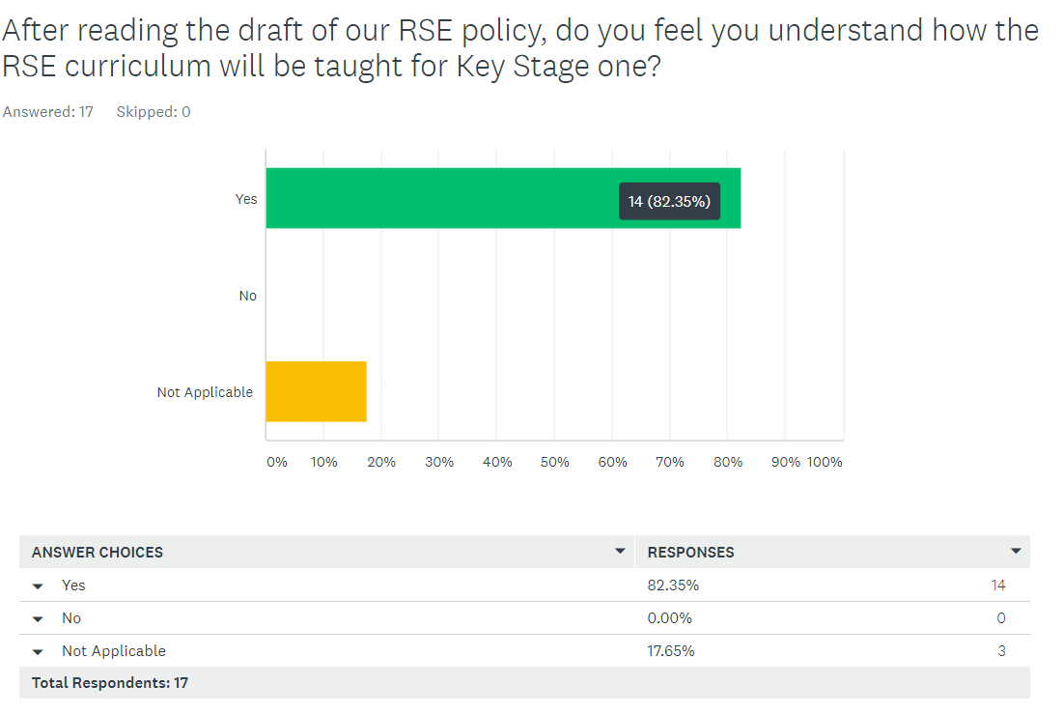
Question 2

Slide 3
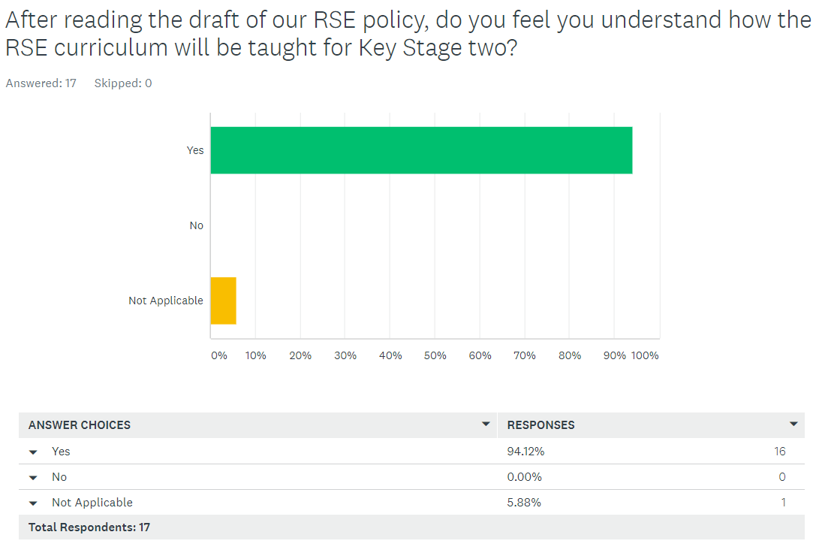
Question 3

Slide 4
Question 4 - Do you have any worries regarding the teaching of RSE?
17/17 respondents say they have no worries about the teaching of RSE.

Slide 5
Question 5 - Do you feel able to talk to your child about relationships and sex?
17/17 respondents say they are comfortable talking to their child about sex when age appropriate.

Slide 6
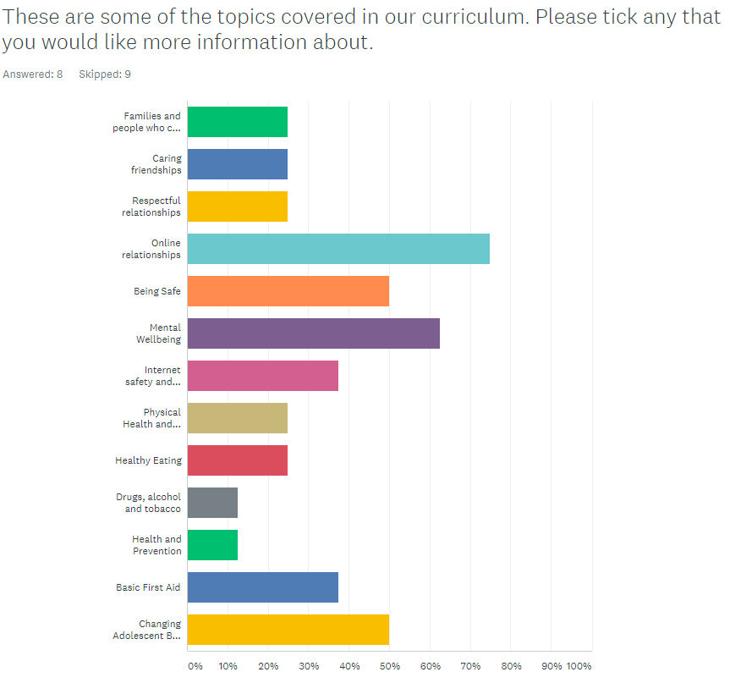
Question 6
Please see slide 8 -11 for more information.

Slide 7
Question 8 - Would you like to see any other topics being covered?
Out of the 17 responses, parents noted that these are the subjects they would like to see covered:
Same-sex relationships
Danger of online relationships
Consent
Online bullying
All four of these topics will be covered through the relationships, living in the wider world and the health and wellbeing topics.

Slide 8
More information about topics being taught
The next few slides pick out some of the objectives taught from Year 1 – Year 6 that best represent what the children will know by the time they leave school in Mental Wellbeing, First Aid, Growing and Changing, Online Relationships and Media Literacy and Digital Resilience.
In the long term plan, you will see the overarching objective taught for each subheading, please refer to that for more information.

Slide 9
More information about topics being taught
Online Relationships
how knowing someone online differs from knowing someone face to face and that there are risks in communicating with someone they don’t know
what to do or whom to tell if they are worried about any contact online
Physical Health and Mental Wellbeing
Keeping healthy; food and exercise, hygiene routines; sun safety
Why sleep is important; medicines and keeping healthy; keeping teeth healthy; managing feelings and asking for help
Health choices and habits; what affects feelings; expressing feelings
Maintaining a balanced lifestyle; oral hygiene and dental care
Healthy sleep habits; sun safety; medicines; vaccinations; immunisations and allergies
What affects mental health and ways to take care of it; managing change, loss and bereavement; managing time online

Slide 10
More information about topics being taught
Growing and Changing
Physical and emotional changes in puberty
to recognise some of the changes as they grow up e.g. increasing independence
about what being more independent might be like, including how it may feel
about the transition to secondary school and how this may affect their feelings
about how relationships may change as they grow up or move to secondary school
practical strategies that can help to manage times of change and transition e.g. practising the bus route to secondary school
First Aid
to identify when situations are becoming risky, unsafe or an emergency
to identify occasions where they can help take responsibility for their own safety
to differentiate between positive risk taking (e.g. trying a challenging new sport) and
dangerous behaviour
how to deal with common injuries using basic first aid techniques
how to respond in an emergency, including when and how to contact different
emergency services

Slide 11
More information about topics being taught
Media Literacy and Digital Resilience
about the benefits of safe internet use e.g. learning, connecting and communicating
how and why images online might be manipulated, altered, or faked
why people choose to communicate through social media and some of the risks and challenges of doing so
that social media sites have age restrictions and regulations for use
the reasons why some media and online content is not appropriate for children
about sharing things online, including rules and laws relating to this
how to recognise what is appropriate to share online
how to report inappropriate online content or contact

Slide 12
Thank you!
Thank you for your support with our RSE Parent Consultation. We really appreciate your feedback and endeavor to use your feedback to enhance our RSHE curriculum.

