Slide 1
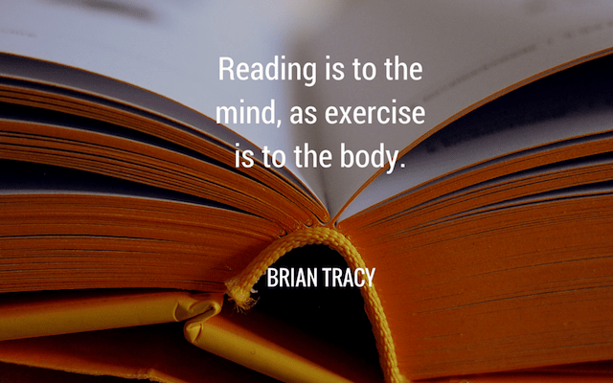
Accelerated Reader at Matching Green CofE Primary School

Slide 2
What is Accelerated Reader?
Accelerated Reader (AR) is a computer programme that helps teachers manage and monitor children’s independent reading practice. Your child picks a book at their own level and reads it at their own pace. When finished, your child takes a short quiz on the computer/iPad – passing the quiz is an indication that your child has understood what has been read. AR gives both children and teachers feedback based on the quiz results, which the teacher then uses to help the child set targets and ongoing reading practice.

Slide 3
Why are we using Accelerated Reader?
AR helps all children become better readers from pupils with special needs to those who are higher ability.
AR encourages children to read for at least 20-30 minutes each day and rewards effort and achievement.
When children read books at their appropriate level they experience success and grow in confidence and reading stamina.
The teachers work with children to set appropriate targets based on each child’s reading ability.

Slide 4
Why is reading so important?
According to Renaissance Learning’s research, children who read at least 20 minutes a day with a 90% comprehension rate on AR quizzes see the greatest gains.
Therefore, your child should have at least 20 minutes set aside for reading during the day.

Slide 5
Introduction to the Programme
There are two different parts of the programme that work together to support our children with their reading.
Star Reading Test
A computer adaptive reading test used to assess pupils’ reading ability and to determine their recommended reading levels for AR. Measures growth over time. Your child will take part in this assessment once a term.
Accelerated Reader Quiz
A database of quizzes to test comprehension of books read. Provides instant feedback and monitoring.

Slide 6
Taking the Star Reader Test
Only takes ten minutes
Measures a child's reading growth and progress
Computer adaptive (makes the test easier or harder depending on the answers a child has given)
Provides real time data – reading ages compared to chronological age, national curriculum level
Provides the important Zone of Proximal Development (ZPD) information.

Slide 7
Taking the Accelerated Reading quiz
In most cases, children really enjoy taking the quizzes. Since they are reading books at their own reading and interest levels, they are likely to be successful. This is satisfying for most children. Best of all, they learn and grow at their own pace.

Slide 8
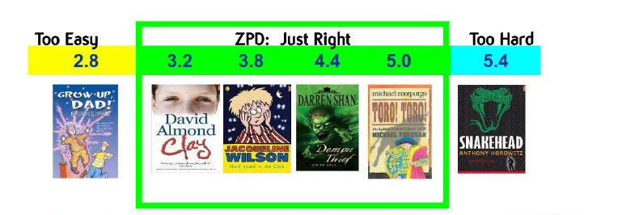
AR Books and ZPD
AR Books
Each quizzed book has a book level which represents the difficulty of text.
ZPD (Zone of Promixmal Development)
A ZPD is the range of books that will challenge a child without causing frustration or loss of motivation. Each child will receive their ZPD, or reading range, after taking a Star Reading Test. It is important for children to read with a high degree of reading comprehension within their ZPD.

Slide 9
Accelerated Reader at our school
We have invested a lot of time and effort relabelling and organising our reading books in school to facilitate this reading program.
Class teachers will assist the children in finding a suitable book at their ZPD level.

Slide 10
Choosing a Book
Pupils select books appropriate for their reading level and interests.
Books are labels in the following ways to help guide choices:
Book Level: The difficulty of text (0.1-9.9) Pupils are recommended to read from the beginning of their ZPD.
Points: Refers to the length and number of words within a book.
Interest Levels: Every book that has an AR quiz is assigned an interest level to identify which age group a book is appropriate for, based on the content and themes within the book.
Interest Levels | Age
LY – Lower Years | 5-8
MY – Middle Years | 9-13

Slide 11
Taking the Book Quiz
The children must complete the quiz within 24 hours of completing the book
The questions are multiple choice
Children can earn points based on their score
The book quiz also provides an opportunity for the children to Practice their vocabulary and reinforce new words they have learnt throughout the text and allows them to practice their comprehension skills.

Slide 12
Where are we up to?
All children have taken the star reading test on the computer and teachers know the pupil’s ideal reading level. This is the ZPD range.
Children are now choosing their reading books according to their ZPD range.
Your child’s ZPD range is stuck in their reading records.
Some children are already reading more, making better progress and are enjoying taking a quiz!

Slide 13
Children’s Progress
Children can see what books they have read and how they did. The programme also gives them suggestions on what to read next based on their interest and ability.

Slide 14
How can you encourage this?
Encourage your child to read at home because they will get better at reading if they practise.
Create a culture of reading in your household by reading with your child, having a collection of books at home, visiting libraries or bookshops and by letting your child see you reading…even if just a magazine!
When reading with your child, stop and ask them questions about the text to be sure your child is understanding what they have read.
Try to regularly discuss books that everyone in your family is reading or has read.

Slide 15
How does my child’s ZPD compare with their peers?
The short answer is…IT DOES NOT MATTER!
Your child is reading at a ZPD that is appropriate for them and where they need to be.
Each child is an individual, with individual needs, capabilities, interests and abilities and AR caters for this. Your class teacher will inform you at parents evening if your child is working at an age appropriate level.

Slide 16
Why is my child’s ZPD range so wide or so narrow?
This depends on skills your child has mastered and skills they need to develop. The ZPD will broaden as your child becomes secure with a skill, be that decoding, word recognition, inferring or retrieving.

Slide 17
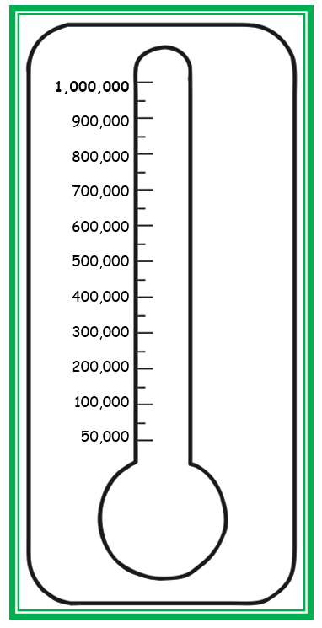
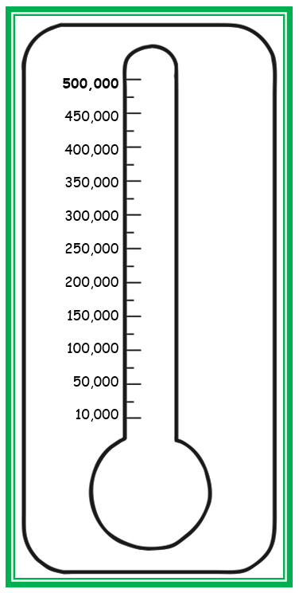
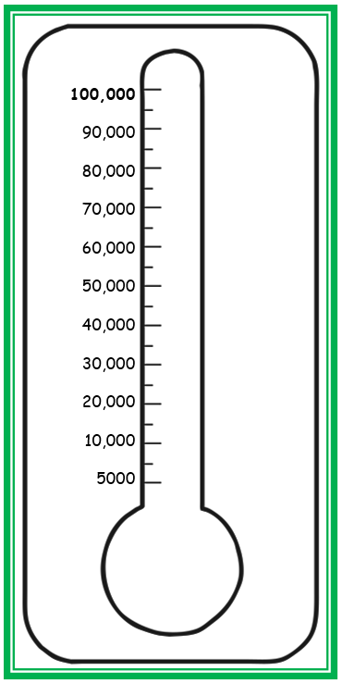
Get excited about reading!
Each class will have a thermometer in their class. Each week we will colour in the thermometer based on how many words the children have read.
The children are very excited to hear how well they are performing and every half term, if the children reach their goal they will receive a special treat.
Shakespeare will try to read 1,000,000 words in a half term!
Darwin will try to read 500,000 words in a half term!
Nightingale will try to read 100,000 words in a half term!

Slide 18
Any Questions?
If you have any questions, please speak to your child’s class teacher or to our English reading coordinator, Miss Roach.

